Slide 1
Introduction to selenium webdriver
Qa Community
Rosario – Argentina
February 2019

Slide 2
Index
Webdriver
Webdriver architecture
Browser compatibility
Language supported
Methods
Explicit and Implicit Waits
What is a framework
Most popular selenium framework
Introduction to Selenium Grid

Slide 3

Introduction to Selenium
Selenium is a free (open source) automated testing suite for web applications across different browsers and platforms. it is focuses on automating web-based applications. Testing done using Selenium tool is usually referred as Selenium Testing.
The entire suite of tools results in a rich set of testing functions specifically geared to the needs of testing of web applications of all types. These operations are highly flexible, allowing many options for locating UI elements and comparing expected test results against actual application behavior. One of Selenium’s key features is the support for executing one’s tests on multiple browser platforms.
Selenium is not just a single tool but a suite of software's, each catering to different testing needs of an organization. It has four components.
Selenium Integrated Development Environment (IDE)
Selenium Remote Control (RC)
WebDriver
Selenium Grid

Slide 4

WebDriver
WebDriver is a remote-control interface that enables introspection and control of user agents. It provides a platform- and language-neutral wire protocol as a way for out-of-process programs to remotely instruct the behavior of web browsers.
Provided is a set of interfaces to discover and manipulate DOM elements in web documents and to control the behavior of a user agent. It is primarily intended to allow web authors to write tests that automate a user agent from a separate controlling process, but may also be used in such a way as to allow in-browser scripts to control a — possibly separate — browser.

Slide 5
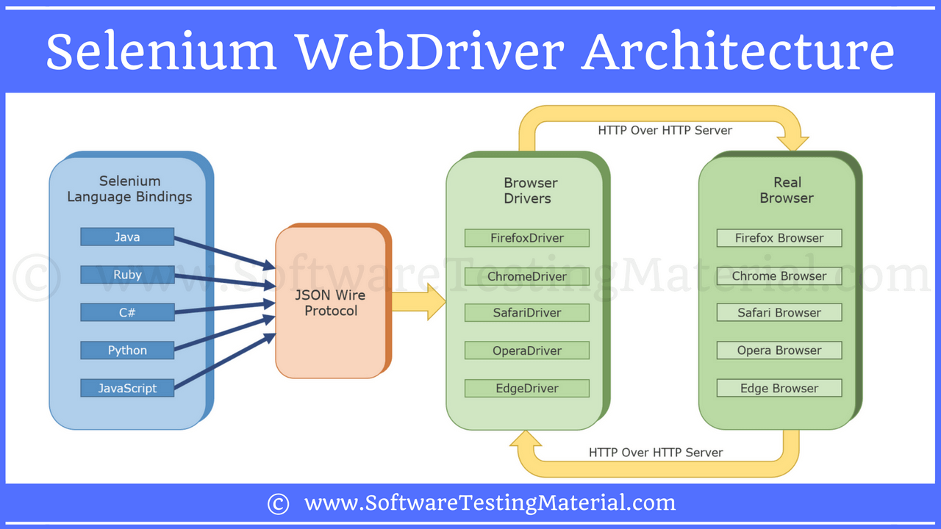
WebDriver Architecture
There are four components of Selenium Architecture:
Selenium Client Library
JSON Wire Protocol over HTTP
Browser Drivers
Browsers

Slide 6
WEBDRIVER ARCHITECTURE
Selenium Client Libraries/Language Bindings:
Selenium supports multiple libraries such as Java, Ruby, Python, C#, etc.
For instance, if you want to use the browser driver in java, use the java bindings
Check out Selenium Libraries in the official site.
Browser Drivers:
Each browser contains separate browser driver. Browser drivers communicate with respective browser without revealing the internal logic of browser’s functionality. When a browser driver is received any command then that command will be executed on the respective browser and the response will go back in the form of HTTP response
JSON WIRE PROTOCOL Over HTTP Client:
JSON stands for JavaScript Object Notation. It is used to transfer data between a server and a client on the web. JSON Wire Protocol is a REST API that transfers the information between HTTP server. Each BrowserDriver (such as FirefoxDriver, ChromeDriver etc.,) has its own HTTP server.
Browsers:
Browsers supported by Selenium WebDriver:
Internet Explorer
Mozilla Firefox
Google Chrome
Safari
etc

Slide 7
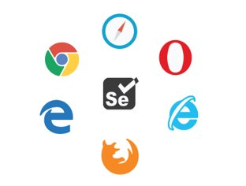
Browser compatibility
Selenium-WebDriver supports the following browsers along with the operating systems these browsers are compatible with.
Google Chrome
Internet Explorer 7, 8, 9, 10, and 11.IE 6 is no longer supported. The driver supports running 32-bit and 64-bit versions of the browser where applicable
Firefox
Safari
Opera
HtmlUnit
phantomjs
Android (with Selendroid or appium)
iOS (with ios-driver or appium)

Slide 8
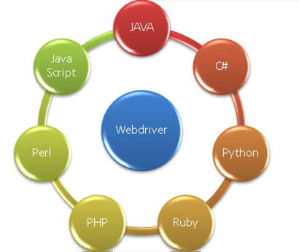
Lenguage Supported
The thing that makes Selenium WebDriver superior to other web automation tools is the wide range of language and framework options it provides to the users for writing test scripts.
Selenium WebDriver supported languages include:
Java
Python
Ruby
C#
JavaScript
Perl
PHP

Slide 9
METHODS
We have so many webdriver methods to automate the web application. Selenium provided huge number of methods to interact with the browser to automate the applications. Each method will have its own purpose to use.
There are several methods that are available from the Webdriver interface. These methods are accessed using the instance variable driver in a simple format driver.methodName();. All these automation projects include calling these methods and comparing & evaluating what they return.
In simple terms, we can generally classify Webdriver commands as Browser commands, Get commands, Navigation commands, Webelement commands, Action commands and Result commands. In the following slide We will see the most important methods on WebDriver.

Slide 10
Methods
WEBDRIVER METHODS. | Web operations on web Elements
1. get (). | 1.click().
2. getCurrentUrl(). | 2.sendkeys().
3. getTitle(). | 3.clear().
4. getPageSource(). | 4.getText().
5. findElement(). | 5.getTagName().
6. findElements(). | 6.getLocation().
7. close(). | 7.isSelected().
8. quit(). | 8.isDisplayed().
9. getWindowHandle(). | 9.isEnabled().
10. getWindowHandles(). | 10.getAttribute().
11. switchTo().
12. navigate().
13. manage().

Slide 11
METHODS
get(): It will be used to navigate to the particular website. It accepts the url as an argument.
getCurrentUrl(): It will give the url of the currently focused web page in the form of string.
getTitle(): It will return the title of the currently focused web page in the form of string.
getPageSource(): It will return the entire page source(i.e. Html code) of the currently focused web page in the form of string.
findElement(): It will identify the single web element on the web page.
findElements(): It will identify the list of web elements which is having same locator.
close(): It will close the current browser where the driver focus is.
quit(): It will be used to close all the web pages which are opened by the webdriver.
getWindowHandle(): It will be used the get the current window information. By using this we can switch between the windows. Return type of this method is WebDriver.
getWindowHandles(): It will hold all the windows information which are opened by the web driver. By using these information we can switch between the opened windows.
switchTo(): This will be very helpful to switch between the windows, frames and alters in the application.

Slide 12
METHODS
navigate(): It will be used to navigate to the previous and next web pages.
manage(): This is used to perform maximize the size of the window.
click(): This method is used to click on the buttons or links on the web page.
sendKeys(): This method is used to enter the data into the textbox.
clear(): This method is used to clear the content of the textbox.
getText(): This is used to capture text of the webElement.
getTagName(): This is used to capture html tag of the webElement.
getLocation(): This is used to capture X and Y co-ordinates of webelement in the application.
isSelected(): This is used to check, is the check-box is currently checked or unchecked to checked Radio buttons are selected or not.
isDisplayed(): This is a Boolean condition. It is used to either an element is visible or not. If an element is displayed it gives true and an element is not displayed it gives false.
IsEnabled(): This is a Boolean condition. It is used to either an element is enable or not. If an element is enable it gives true and an element is disable it gives false.
getAttribute (): This method will be used to get the attribute values of a particular locator.

Slide 13
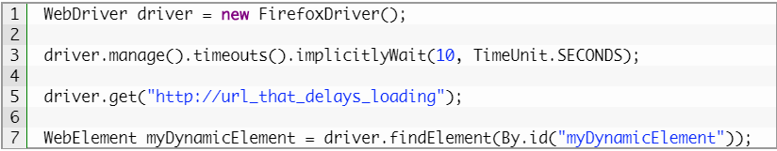
Explicit and implicit waits
Implicit Wait: An implicit wait is to tell WebDriver to poll the DOM for a certain amount of time when trying to find an element or elements if they are not immediately available. We should note that implicit waits will be in place for the entire time the browser is open. This means that any search for elements on the page could take the time the implicit wait is set for.

Slide 14
EXPLICIT AND IMPLICIT WAITS
Explicit wait: an explicit wait is used to halt the execution until the time a condition is met, or the maximum time has elapsed. Unlike Implicit waits, Explicit waits are applied for a particular instance only.

Slide 15
EXPLICIT AND IMPLICIT WAITS
Difference In Definition
Implicit Wait
Tell WebDriver to poll the DOM for a certain amount of time. This is literally using the ImplicitWait property that Selenium WebDriver offers.
Waits for an element to exist in the DOM, that’s it. Cannot tell if an element is hidden for example.
Only needs to be configured once
Less flexible
Explicit Wait
This is the code that you write to wait for a certain condition to occur before proceeding. You can use the WebDriverWait class, Thread.Sleep, or write your own from scratch.
Recommended way to wait in your tests
The easiest way to use this is through the WebDriverWait class that Selenium provides us
Selenium will try an action repeatedly (is element visible, is element present, is button clickable…) until the action can be accomplished or an exception is thrown

Slide 16
EXPLICIT AND IMPLICIT WAITS
Disadvantages
Implicit Wait
An implicit wait only works with elements that exist on the page. If the element is hidden in the DOM, an implicit wait will never work. So you will be forced to use an explicit wait to synchronize on that element. An in depth example is here. Also, an element may be present in the DOM, but not fully loaded. ImplicitWait will still return because that element is present.
the implicit wait sends a message to the “remote side” of the selenium WebDriver. The remote side of the selenium WebDriver is the part of selenium which is actually controlling the browser. What does the remote side do with the message? “It depends”. It depends on the operating system and on the browser and on the version of selenium. As far as I can tell there is no guarantee about the actual behaviour of a specific implementation. Meaning, we have no clue about how the implicit wait will behave (StackOverFlow)
Explicit Wait
You need to use more lines of code to create an explicit wait

Slide 17
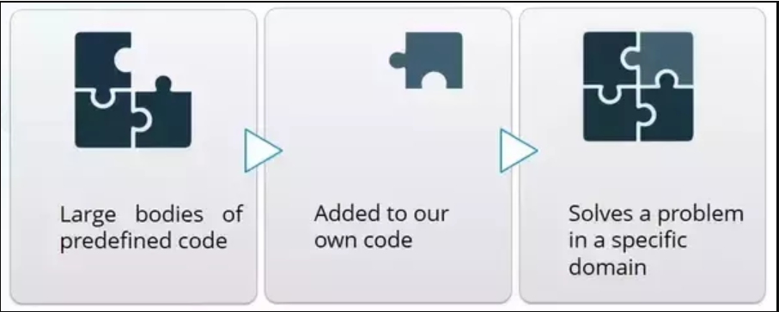
What is a framework
A software framework is a universal, reusable software environment that provides particular functionality as part of a larger software platform to facilitate development of software applications, products and solutions. Software frameworks may include support programs, compilers, code libraries, tool sets, and application programming interfaces (APIs) that bring together all the different components to enable development of a project or system
Let’s understand it through a pictorial representation:

Slide 18
WHAT IS A FRAMEWORK
advantages
Open Source : Most of the Frameworks are open source. So you don’t need to pay any money to use them. Again due to open source nature of any Framework, you can modify and reuse any Framework of your choice and build your own Framework from existing Framework when you need them.
Support and Documentation: Good Support and Documentation are 2 must have things for any good framework. You will defiantly need them while you learn and use any framework. Most of the Framework comes with Good documentation. So that you can learn them easily. When it comes to support, there are many forums where you can go and ask questions to find out solutions of your problem.
Efficiency: Framework will make your code efficient. This is one of the major reason why Framework is used widely. With the help of Framework, you can reduce your repetitive code and improve the efficiency of application.
Security: There are high chances that Framework which you are using is used by other good developers and most of the security risks are addressed. There are many guides which you can use to improve the security of particular Framework as well.
Integration with other tools : I am sure if you are developing something then you need data. To store and retrieve data, you will need database. There are many other such tools which you need while working on BIG Applications. So Framework will enable you to integrate those tools easily in your application.

Slide 19
WHAT IS A FRAMEWORK
DISadvantages
Restrictions: The framework’s fundamental behavior cannot be changed, indicating that when you use a framework, you are required to respect its limitations and work the way it is required. Thus, you must ensure that you choose a framework that fits your needs.
Code is public: Since the framework is readily available to everyone, it is also offered to people with bad intentions. It can be studied in order to know how things work and to discover flaws that can be utilized against you.
Custom Features: When you are making use of a framework, you know very little about the language behind it, you will learn the framework and not the language itself. The features in it are custom built.
Time: Learning will also be consider as one of the limitation because you cannot learn every framework. You need to invest some valuable time while learning any new framework.

Slide 20
Most popular selenium framework
There are mainly three type of frameworks created by Selenium WebDriver to automate manual test cases:
Data Driven framework
Keyword Driven framework
Hybrid framework
More Information and examples in the following's links:
First Link
Second Link

Slide 21
MOST POPULAR SELENIUM FRAMEWORK
We have other Frameworks that work with Selenium and they are the followings:
Selenium WebDriver Framework Code
Golem Automated Testing Framework
Page Object Model Framework
BDD Frameworks
SpecFlow BDD Automation
Serenity
BDD Sample Code
Cucumber
Jasmine
More Information about Frameworks and extra information in these Links:
Link 1
Link 2
Link 3

Slide 22
Introduction to Selenium Grid
What is Selenium Grid?
The Selenium Grid is a testing tool which allows us to run our tests on different machines against different browsers. It is a part of the Selenium Suite which specialise in running multiple tests across different browsers, operating system and machines. You can connect to it with Selenium Remote by specifying the browser, browser version, and operating system you want. You specify these values through Selenium Remote’s Capabilities.
There are two main elements to Selenium Grid
Hub
and nodes
What is A Node?
In Selenium Grid, a node is referred to a Test Machine which opts to connect with the Hub. This test machine will be used by Hub to run tests on. A Grid network can have multiple nodes. A node is supposed to have different platforms i.e. different operating system and browsers. The node does not need the same platform for running as that of hub.

Slide 23
INTRODUCTION TO SELENIUM GRID
WHAT IS A HUB?
In Selenium Grid, the hub is a computer which is the central point where we can load our tests into. Hub also acts as a server because of which it acts as a central point to control the network of Test machines. The Selenium Grid has only one hub and it is the master of the network. When a test with given DesiredCapabilities is given to Hub, the Hub searches for the node witch matches the given configuration. For example, you can say that you want to run the test on Windows 10 and on Chrome browser with verision XXX. Hub will try to find a machine in the Grid which matches the criterion and will run the test on that Machine. If there is no match, then hub returns an error. There should be only one hub in a Grid.

Slide 24
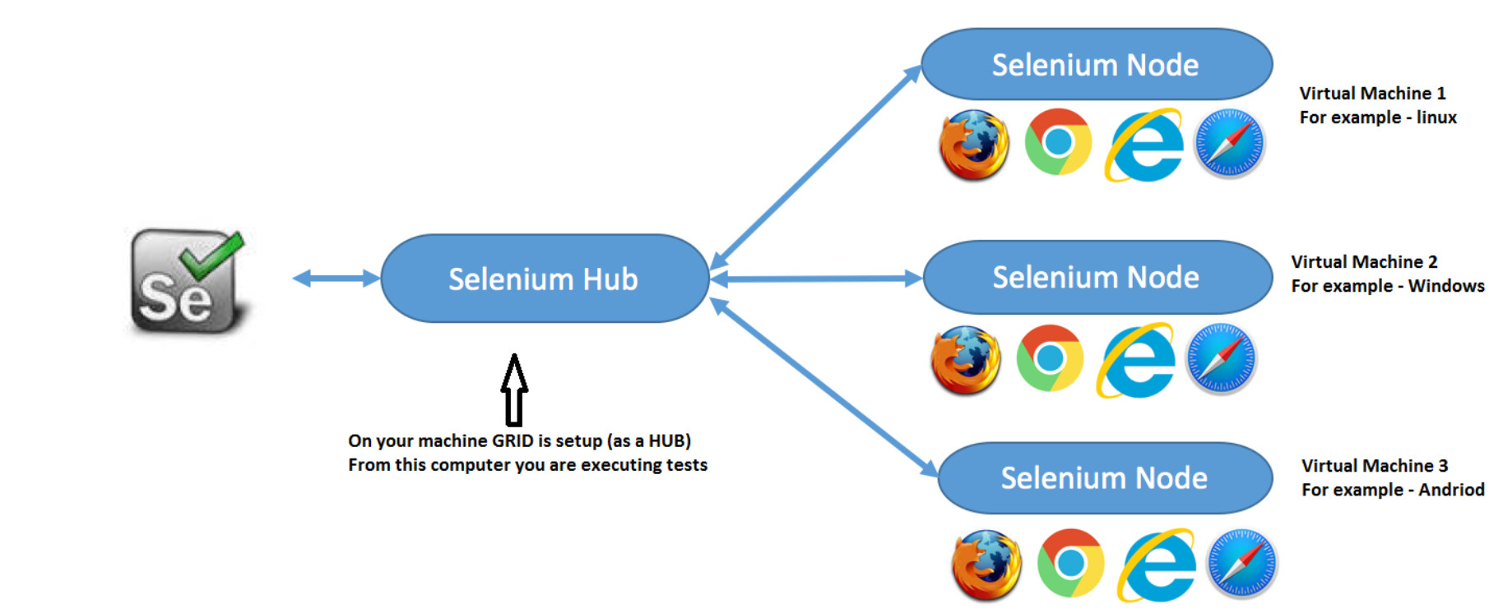
INTRODUCTION TO SELENIUM GRID
How it works?
First you need to create a hub. Then you can connect (or “register”) nodes to that hub. Nodes are where your tests will run, and the hub is responsible for making sure your tests end up on the right one (e.g., the machine with the operating system and browser you specified in your test).

Slide 25
References
https://www.softwaretestinghelp.com/selenium-webdriver-selenium-tutorial-8/
https://www.loginworks.com/blogs/basic-understanding-selenium-webdriver-architecture/
https://www.softwaretestingmaterial.com/selenium-webdriver-architecture/
https://www.seleniumhq.org/about/platforms.jsp
https://onlinetraining.etestinghub.com/webdriver-methods-web-elements/
https://www.guru99.com/accessing-forms-in-webdriver.html
https://www.seleniumhq.org/docs/04_webdriver_advanced.jsp
https://simpleprogrammer.com/best-automation-frameworks/
https://www.toolsqa.com/selenium-webdriver/selenium-grid/

Slide 26
THANK YOU!!
PABLO EXEQUIEL GIMENEZ
QA Automation
PABLOEXEQUIEL.GIMENEZ@ENDAVA.COM

